Slide 1
Smart Home Automation and Security System with Human Detection
Jerin Romijah Tuli
Roll: 2003056
Section: A
Department of CSE

Slide 2

Introduction to Smart Home Automation and Security System
we develop an integrated home automation and security system utilizing an Arduino Uno microcontroller. The system enhances home security by first detecting human presence using an ultrasonic sensor. Upon detection, it prompts the user to enter a password via a keypad to unlock the door. Once unlocked, the system transitions into an automation mode, controlling lighting based on ambient light and occupancy, while also monitoring gas levels for safety. A Liquid Crystal Display (LCD) provides real-time feedback to the user regarding the system’s status and sensor readings.

Slide 3
Overview of Smart Home Automation and Security System
Developed an integrated home automation and security system.
Utilizes Arduino Uno microcontroller.
System detects human presence using an ultrasonic sensor.
Prompts user to enter a password to unlock the door.
Transitions into automation mode to control lights and monitor gas levels.

Slide 4

Components and Sensors Used
Arduino Uno:Controls all operations
Liquid Crystal Display (LCD):Displays user prompts, lock status, and sensor data
4x4 Keypad: Input device for entering the unlock password.
Ultrasonic Sensor (HC-SR04):Detects human presence by measuring distance.
PIR Sensor: Detects motion to determine occupancy for home automation
Gas Sensor (MQ-2): Monitors gas levels to detect potential leaks.
Light Dependent Resistor (LDR): Measures ambient light levels to control lighting.
Relay Module: Controls external electrical devices like lights based on sensor inputs.
EEPROM: Stores the master password securely for the lock mechanism

Slide 5
System Operation
Human detection via ultrasonic sensor.
Password entry via keypad.
Authentication using EEPROM.
Step-by-Step Flow
If correct, transition to automation mode.
Control of lighting and gas monitoring.

Slide 6
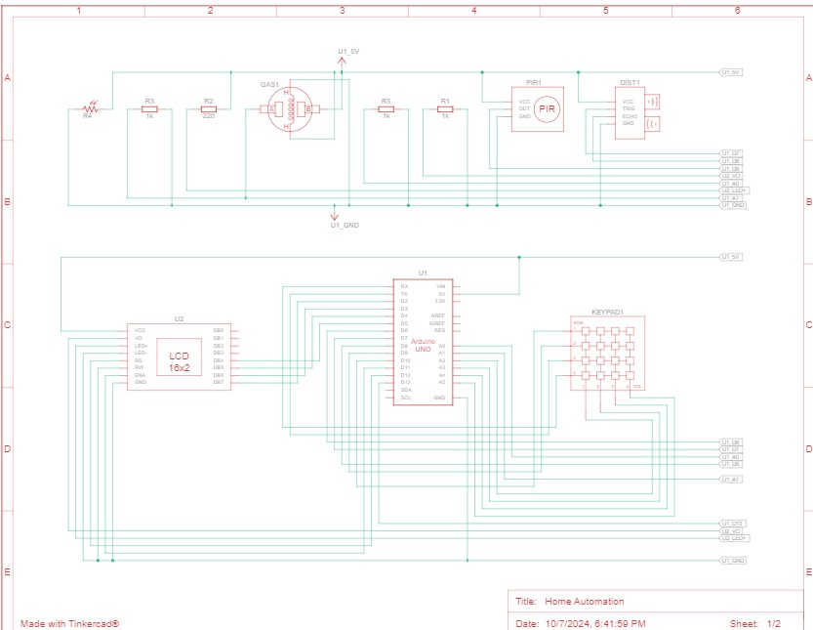
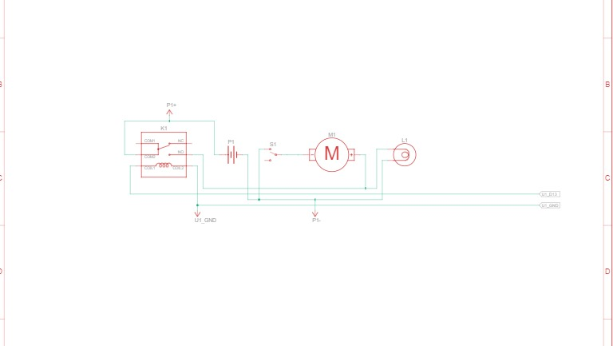
Schematic Diagram
The diagrams shows how the Arduino Uno is connected to the ultrasonic sensor, LCD, keypad, and other components. Each component's pin configuration is labeled for clarity.

Slide 7
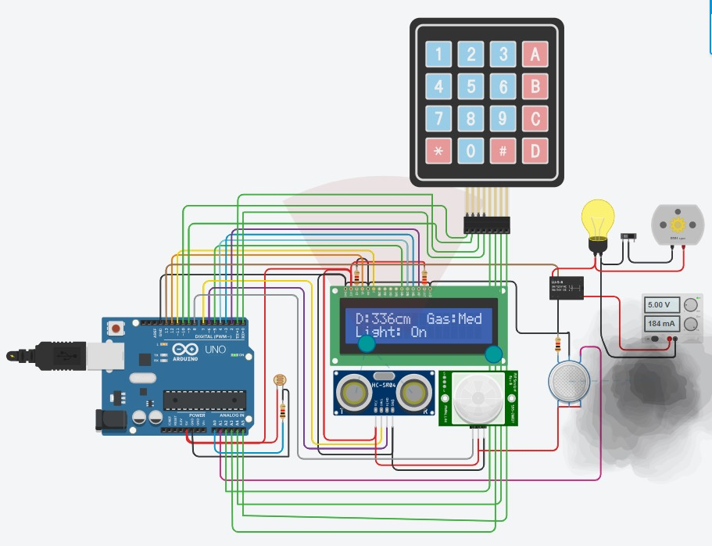
Physical Circuit Implementation
This image displays the assembled circuit, including the Arduino Uno, sensors, LCD, and wiring. It highlights the layout and arrangement of components on the breadboard or PCB.
Circuit Setup Highlights:.
Demonstrates the physical connections as per the schematic diagram.
Provides a visual reference for assembling the system.

Slide 8
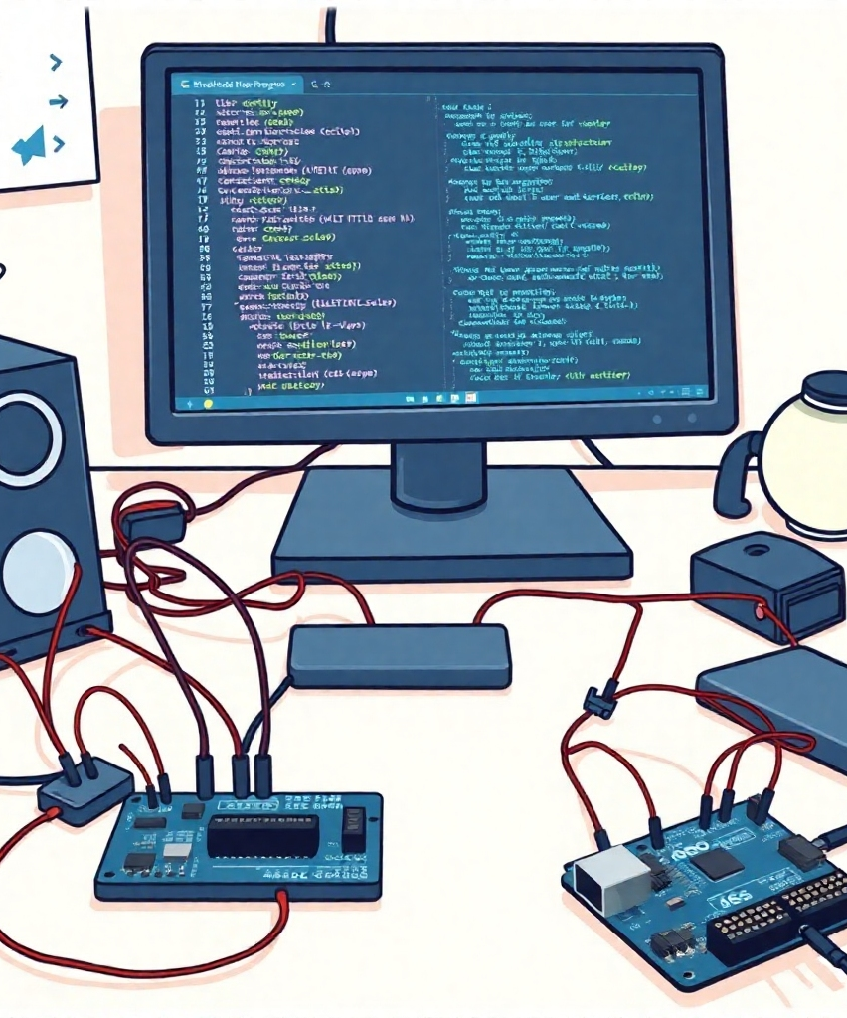
Programming the Arduino Uno for Home Automation and Security
To enable the functionalities of the Smart Home Automation and Security System, the Arduino Uno microcontroller is programmed using the Arduino IDE. The programming involves defining sensor inputs, setting up communication protocols, and implementing logic and control algorithms to automate and secure the home environment.

Slide 9
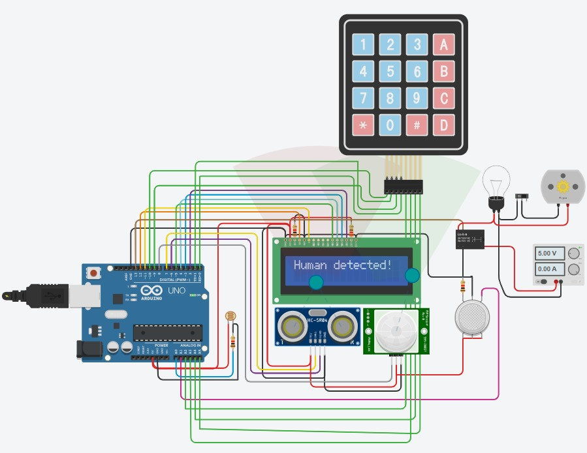
Human Detection Technology
The ultrasonic sensor continuously measures the distance to detect human presence within a predefined threshold (e.g., 20 cm). If a human is detected, the system prompts the user to enter a password.

Slide 10
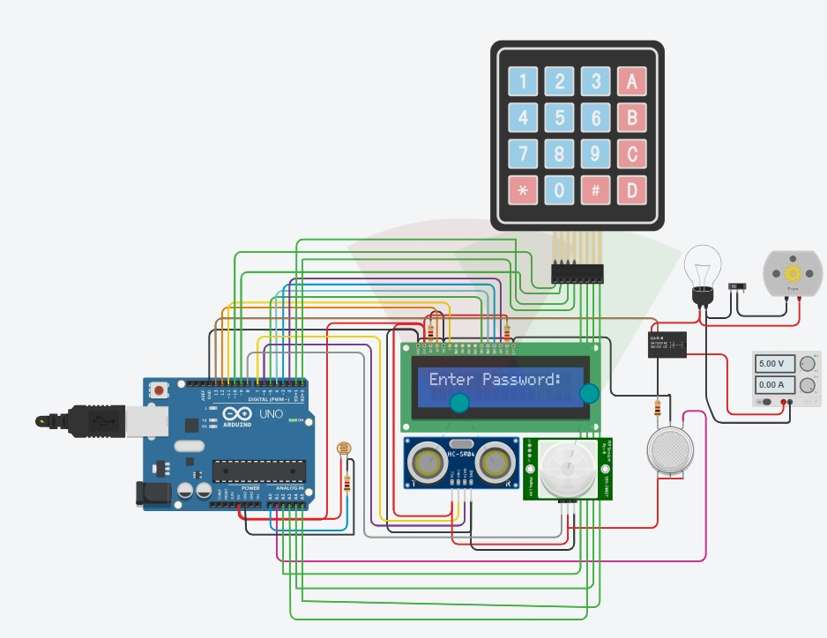
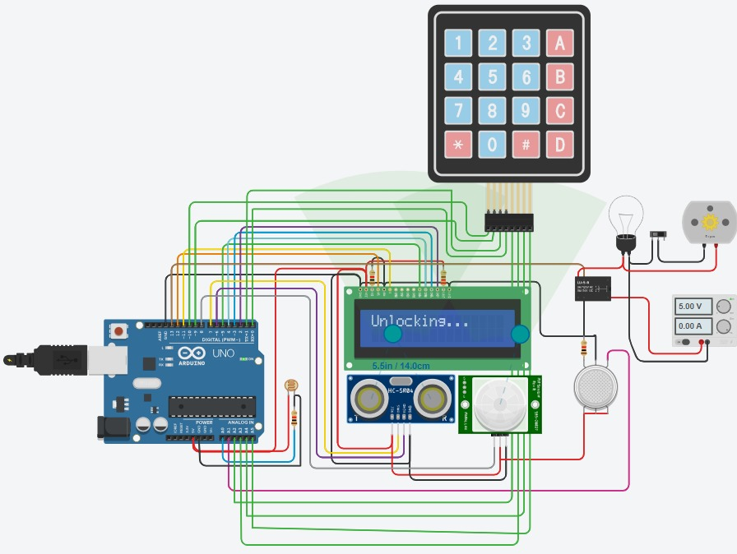
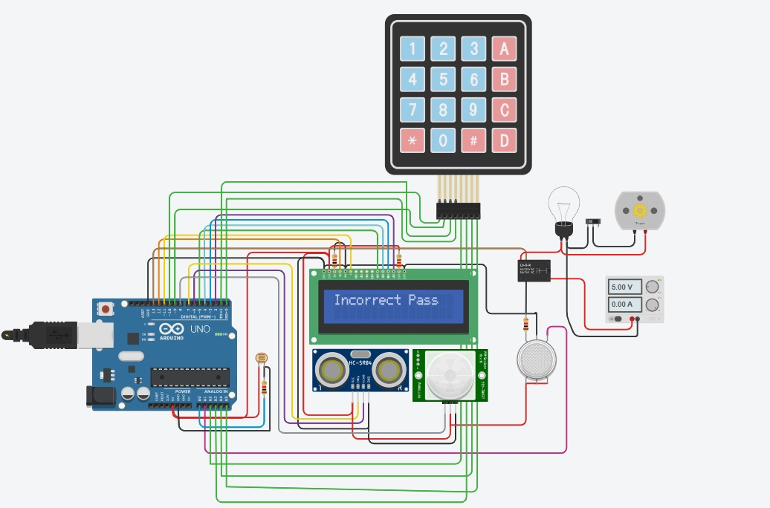
Password Entry and Authentication Process
Password Entry:
Upon human detection, the LCD displays a password entry prompt. The user inputs the password via the keypad. The system verifies the entered password against the stored master password in the EEPROM.
Authentication:
Correct Password: The door unlocks, and the system enters automation
mode, controlling home utilities based on sensor data.
Incorrect Password: An error message is displayed, and the system prompts
for password entry again.

Slide 11
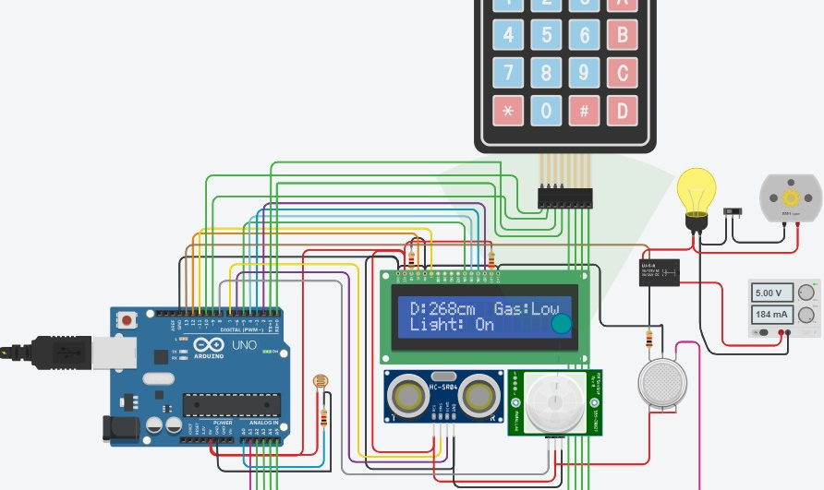
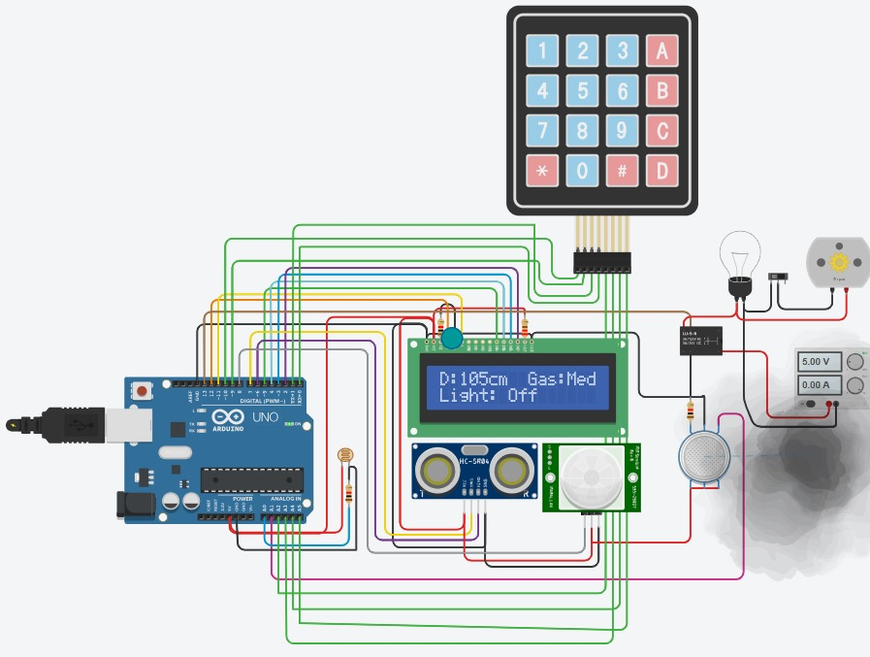
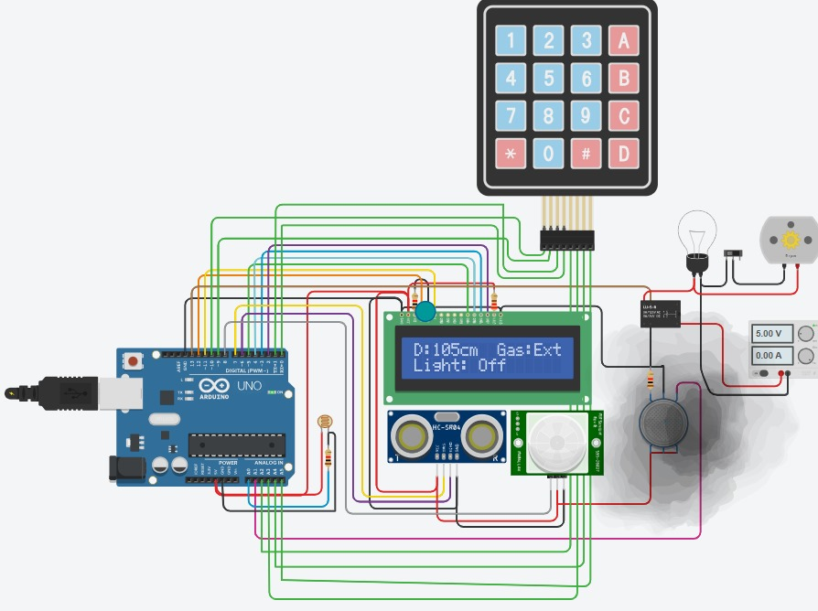
Lighting and Gas Monitoring
In automation mode, the system manages lighting based on ambient light detected by the LDR and occupancy detected by the PIR sensor.
It also monitors gas levels using the gas sensor, triggering alerts if dangerous levels are detected.

Slide 12
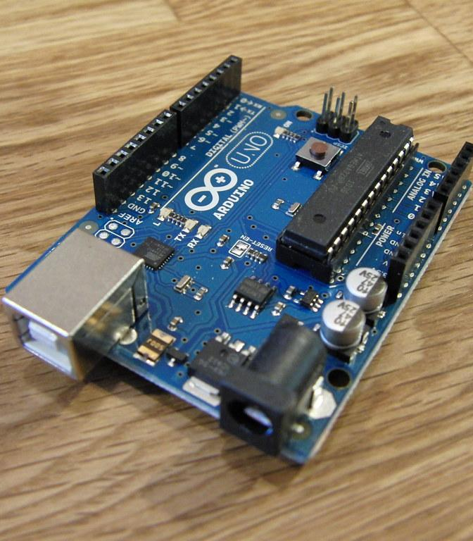
Arduino Uno
Function: Central microcontroller, manages inputs and outputs.
Working:
Controls all sensors and actuators.
Interfaces with other components like LCD and keypad.

Slide 13
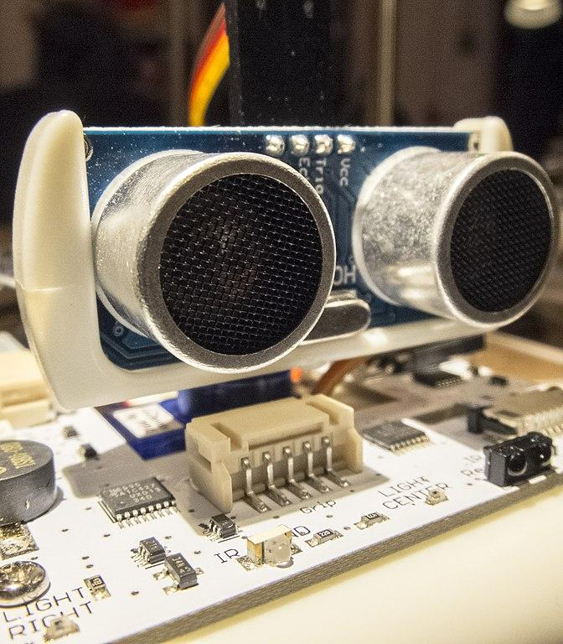
Ultrasonic Sensor (HC-SR04)
Function: Detects human presence by measuring distance
Working:
Emits ultrasonic waves and measures time taken for the echo to return.
Triggers the system if a human is detected within 20 cm.
cm = 0.01723 * readUltrasonicDistance(7, 6);
// Human detected within threshold distance
if (!humanDetected && cm <= distanceThreshold) {
lcd.clear();
lcd.setCursor(0, 0);
lcd.print("Human detected!");
delay(1000); // Wait for 1 second
humanDetected = true; // Mark human as detected
lcd.clear();
enterPasswordDisplayed = false; // Reset flag for password prompt
}

Slide 14
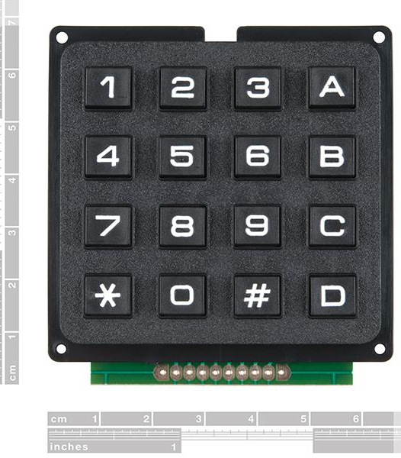
4x4 Keypad
Function: Used to input password for unlocking the door.
Working:
User enters the password on the keypad.
Arduino checks the password against stored data in EEPROM.
if (humanDetected && mode == 0) { // Prompt for password after detection
if (!enterPasswordDisplayed) {
lcd.clear();
lcd.setCursor(0, 0);
lcd.print("Enter Password:");
enterPasswordDisplayed = true; // Ensure password prompt is displayed only once
}
key = keypad.getKey();
if (key) {
Data[data_count] = key;
lcd.setCursor(4 + data_count, 1);
lcd.print("*");
data_count++;
}

Slide 15
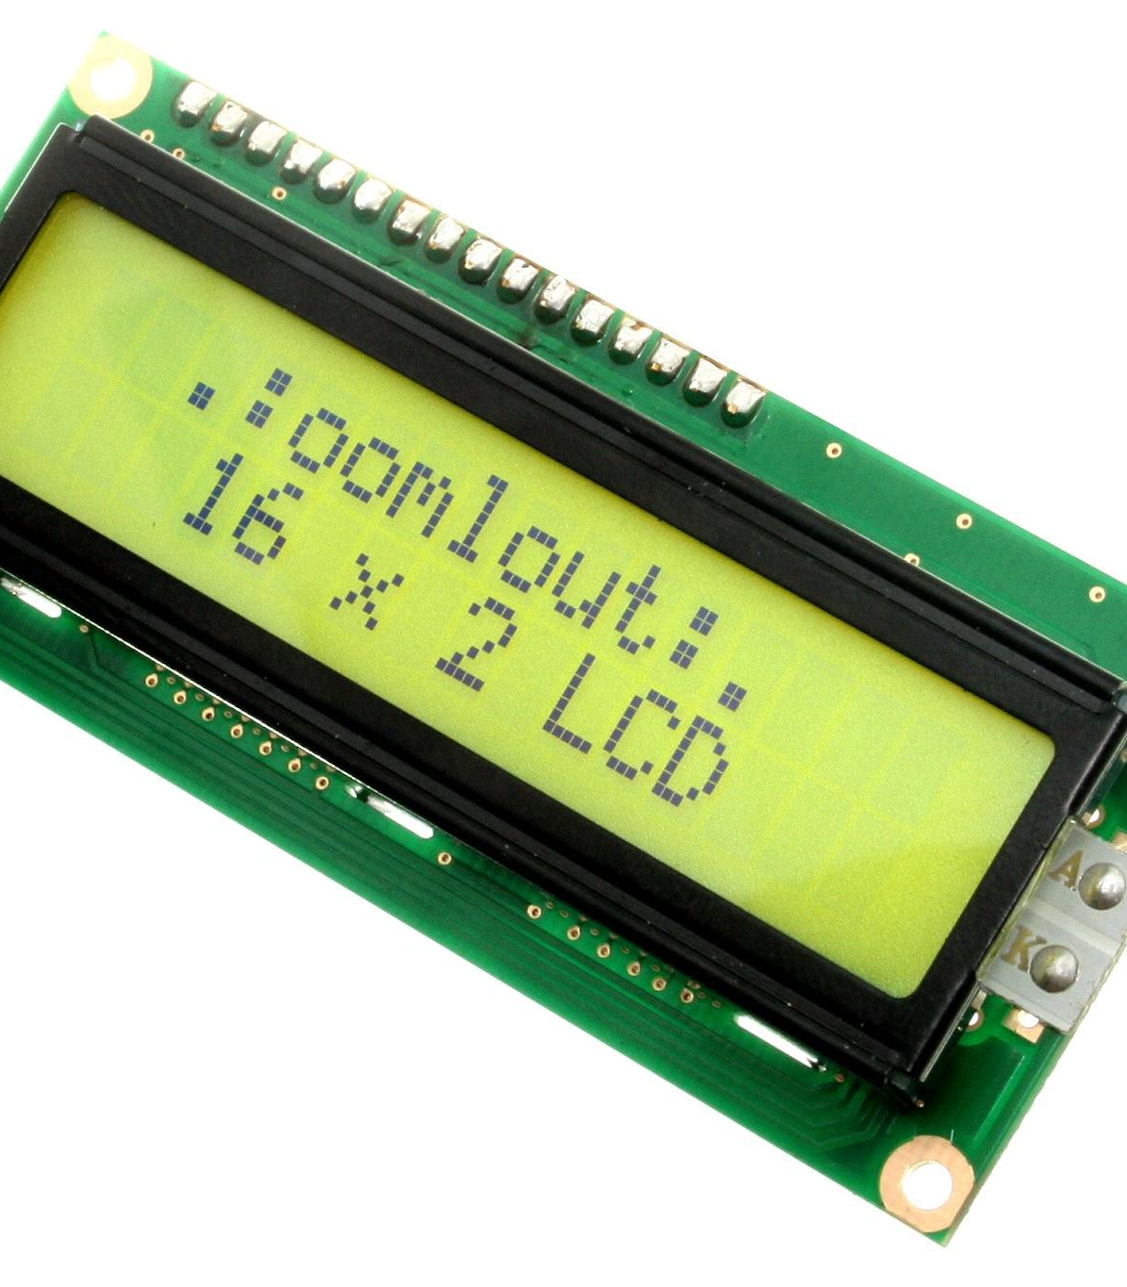
Liquid Crystal Display (LCD)
Function: Provides real-time feedback on system status.
Working:
Displays prompts like “Enter Password” and shows sensor readings.
Visual feedback for successful/failed authentication.
if (data_count == Password_Lenght - 1) {
if (!strcmp(Data, Master)) {
lcd.clear();
lcd.setCursor(0, 0);
lcd.print("Unlocking...");
delay(2000); lcd.clear();
lcd.setCursor(0, 0);
lcd.print("Door Unlocked");
mode = 1;
humanDetected = false;
delay(2000);
lcd.clear();
enterPasswordDisplayed = false; }
data_count = 0; }
else {
lcd.clear();
lcd.setCursor(0, 0);
lcd.print("Incorrect Pass");
delay(2000);
lcd.clear();
lcd.setCursor(0, 0);
lcd.print("Enter Password:"); = true; }

Slide 16
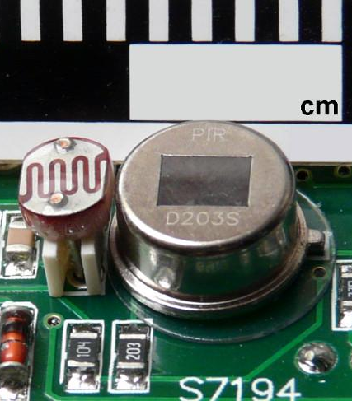
PIR Sensor and LDR
PIR Sensor Function: Detects motion to determine occupancy for automation.
LDR Function: Measures ambient light to control lighting.
.
Working:
If the room is occupied and light is low, the system turns on the lights.
if (resuldoSensorLDR < 600 && val == HIGH) {
digitalWrite(releNO, HIGH);
lcd.setCursor(0, 1);
lcd.print("Light: On ");
delay(5000);
} else {
digitalWrite(releNO, LOW);
lcd.setCursor(0, 1);
lcd.print("Light: Off");
delay(300);
}

Slide 17
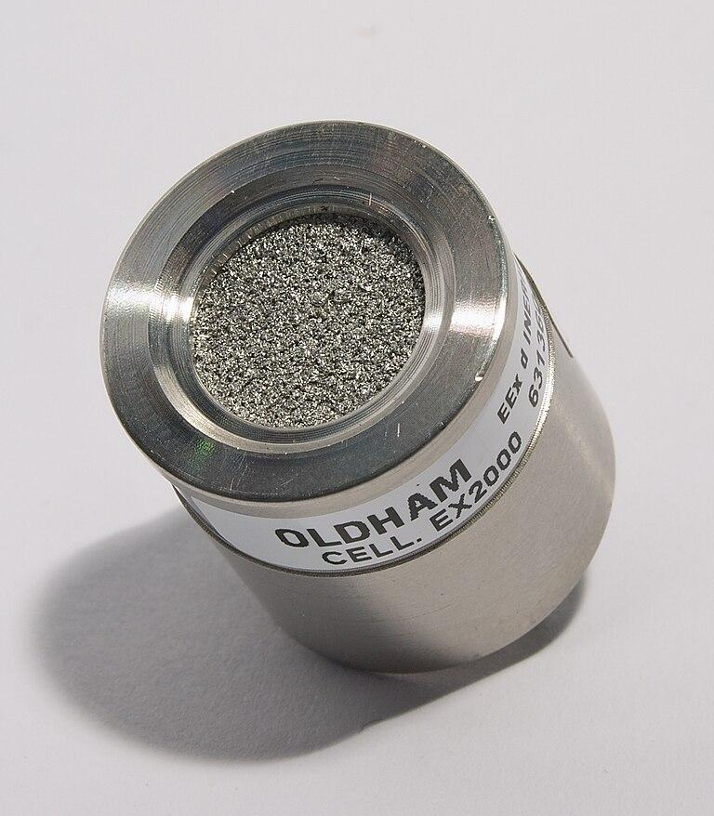
Gas Sensor (MQ-2)
Function: Monitors gas levels to detect leaks.
Working:
Continuously measures gas concentration.
Triggers an alert if dangerous levels are detected
if (gasLevel != previousGasLevel) {
lcd.setCursor(8, 0);
lcd.print(" Gas:");
if (gasLevel <= 85) {
lcd.print("Low ");
} else if (gasLevel <= 120) {
lcd.print("Med ");
} else if (gasLevel <= 200) {
lcd.print("High ");
} else if (gasLevel <= 300) {
lcd.print("Ext ");
}
previousGasLevel = gasLevel; }

Slide 18
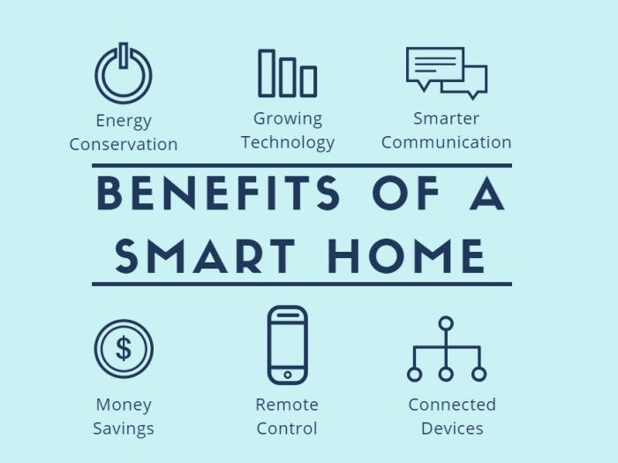
Benefits and Advantages of the Smart Home Automation and Security System
The Smart Home Automation and Security System offers several benefits and advantages to homeowners.
Security Features: Human detection before password input.
Automation: Efficient control of lighting based on occupancy.
Safety: Gas level monitoring to prevent leaks.
Energy Efficiency: Lights only turn on when necessary.

Slide 19

Future Developments and Expansions
Ideas for Improvement:
Add wireless connectivity for remote monitoring.
Mobile application integration.
Expand automation to control more devices.

Slide 20

Conclusion
In conclusion, the Smart Home Automation and Security System with Human Detection offers a comprehensive solution for creating a safe, convenient, and energy-efficient smart home environment. By leveraging the power of the Arduino Uno microcontroller and integrating various sensors and functionalities, this system provides homeowners with control, automation, and security at their fingertips. With the potential for future developments and expansions, the possibilities for creating smarter homes are endless.

